Slide 1
OTHERWORLD DMV
ROLLING THE DICE
When you do something risky, you as the player should decide if you’re rolling for HUMANITY or FAE. Roll 1d6 to find out how it goes.
-If you have an affinity towards HUMANITY, you succeed when you roll under the number you chose in character creation, and fail otherwise.
-If you have an affinity towards FAE, you succeed when you roll over your number, and fail otherwise.
-If you roll your number exactly, you have INSIGHT. You get a special insight into what’s going on. Ask the GM a question and they’ll answer you honestly. Some good questions: What are they really feeling? Who’s behind this? How could I get them to _____? What should I be on the lookout for? What’s the best way to _____? What’s really going on here? (A roll of INSIGHT counts as a success.)
SPECIAL ACTIONS: If you need to seriously persuade someone, make a crucial deal—any action that’s a pivotal moment, you may want to break out your True Name. Names hold weight, and by throwing that weight around things might just tip in your favor.
If you want to bet your True Name on an action, roll 2d6 for it. If you meet or beat your Affinity Number on both rolls, you have an extreme success.
If one dice fails, but one succeeds, your roll is a success but the GM may decide a consequence for your actions.
If your dice fails, you fail hard. You’ve bet your True Name, and lost. The GM (or another player if you’re betting against a party member) must figure out a ROLEPLAY CONSEQUENCE. Your dice rolls will not be affected, and you can still roll for actions normally.
Examples of possible RP consequences may include:
-You’re now indebted to the NPC or Character. They may hold power over you through your True Name
-You take a grave injury, to either your body or soul. This injury might not be physically dealt but could be the manifestation of your loss.
-A physical change — we all love cat girls, but what if you’re a human who suddenly grows beastial traits? Does this change how you think of yourself, how others think of you? Tread carefully here, there’s a line between character catharsis and ableism!
ROLL IDENTITY: Rolling is just the way you show your actions as a character in this game. Keep your rolls and how they’ve influenced your character’s story in the back of your mind as you play!
GM: CREATE AN ADVENTURE
GM: RUN THE GAME
Play to find out how the group responds to the inciting incident. Introduce the game’s setting and how the incident affects it. Does it affect any of your players to start? Make sure to communicate with your players and ask how they would like to react to obstacles and tasks. “You see Luchaveevee the Devious spread pixie dust in the water cooler. What do you do?” “Another bedraggled looking human pops into the DMV from who knows where. Do you approach them?”
Call for a roll when the situation is uncertain. Don’t pre-plan outcomes—let the chips fall where they may. Use failures to push the action forward. The situation always changes after a roll, for good or ill. Encourage players to keep a track of how they roll, how it might influence the story and their character.
Ask questions and build on the answers. “Have any of you had a rowan stake go through your heart before? Where? What happened?”
You’ve found yourself in line with a bunch of other people at the interdimensional Department of Magical Verification. All creatures with magic at some point or another must come here and be verified. This in-between space is a bureaucratic nightmare, but deemed necessary for the balance of the Human and Other worlds. Did you come here on purpose? Did you stumble through a faerie ring? Did a ouiji board session go terribly wrong? Do you have to get home for supper, or are you going to be stuck here for all time? Find out!
Inciting Incidents - roll d12 to determine or mix and match!
1 The DMV's brownies have finally decided to unionize. | 2 Electrical and magical power have both gone out.
3 Almost all the DMV staff have fallen under a sleeping spell. | 4 Each player meets their doppelgänger in the DMV.
5 You find out self-driving cars run on stolen fairy magic. | 6 The DMV has been forcibly stuck in a time and place no one belongs.
7 The (troll) clerk has announced they're taking a nap - for the next century. | 8 In the fine print of a form, you notice you've all been tricked into giving away your first children.
9 The entire DMV is in a panic - the Fairy Queen is visiting! | 10 The English army storms through the door - they're declaring the Fairy World their territory.
11 A dwarf has failed the driving test. Horrendously. They've crashed straight through the front door. | 12 A disgruntled employee has cursed you and you've all started involuntarily shapeshifting!
PLAYERS: CREATE YOUR CHARACTER
1. Choose an upbringing for your character: “Faerie” or
“Human”. Remember, even though you choose here, you don't have exclusively one or the other.
2. Roll a d20 to determine how long you’ve been waiting in the DMV. The higher your roll, the longer you’ve been waiting. Depending on the GM and players, brainstorm how long ago this was. Are you a Roman gladiator stuck here waiting? Are you a K-Pop star who lost their magical ID yesterday?
3. Choose an Affinity Number, from 2 to 5. A high number means you have an affinity towards HUMANITY (quick wit, logic, strength, building, science). A low number means you have an affinity towards FAE (intuition; persuasion; seduction; agility; wild magicks).
4. Give your character a Cool Name for others to call you by, inspired by the time period your character comes from.
5. Choose a True Name—keep this name a secret from other players. DON’T write your True Name down*, lest it be stolen. Remember it, it may come in handy later!
6. Consider a few items your character may have on them, inspired by their background. A magic staff? A bag of tricks? A cell phone?
9. Character goal: Choose one or create your own: Find your long-lost relative in the Otherworld; strike a bargain; get access to the Human World; find out who you truly are.
After creating your character, take a moment and decide on a backstory or circumstance for your character.
Consider where you’d like your character to be from; if they know they might have magical influence; if they know what the Department of Magical Verification is or if they're confused why they’re here.
Write down a few lines, as much as you’d like to flesh it out. Once everyone’s ready, introduce yourself to the GM and players!
Hack by: Zoey Liu, William Lamkin, Fen Argoff, Rachel Lee, and Jay Bellantoni as part of Jonaya Kemper’s Little Games / Big Stories class at Carnegie Mellon University. 2021.
This is a hack of Lasers and Feelings by John Harper (johnharper.itch.io) and is licensed under a CC BY 4.0 license. creativecommons.org/ licenses/by/4.0
*For accessibility purposes, if you can’t remember your character’s True Name, write it down and keep that paper safe and secret!!

Slide 2
NPCs and SETTINGs
NPCs | DMV Settings
A domesticated fae from middle ages who was trafficked to human world and serves as a housemaid for a landlord, understands both human and fae languages, struggling on whether to get a human ID to live easier in human world or a fae ID to go home. A changeling from ancient Rome who can change himself into the figure of a human or a fae. A rock star from 1980s who breaks law for too many times so that his ID was revoked, and he needs to get a new ID. A mother goose with a truly ridiculous amount of baby geese with her. Sentient giant motherfuckin’ mushroom. A fan of that rock star from the 80s. You know, that rock star. They’re trying to escape the slog of High School by getting a Fae ID. A human receptionist who never speaks, only stares. If you stare long enough, you can see...something more in their eyes. A 9-year-old who wandered in via Ouija board, on accident at sleepover Talking cat who’s very put off by you wondering how there’s a talking cat. | Everything is void and drab and empty and the longer you’re there the more spirit like and incorporeal you become. You can hear wind constantly blowing and can’t feel your feet. A watercolor filter over everything, and the sky is green. Cubicles, warm light. You’ve got gray fabric panelling on the walls to muffle sounds, but the persistent murmur of people talking is always there. there are big file cabinets, and many office plants. a water cooler. A metal fan is whirring, with a few little colored streamers coming from it. You can see dust in the air, and it all smells a little old but in a soft nostalgic way Cyberpunk dystopia, everything is gleaming white and silver. There are leds embedded in the ceiling and floor, and everyone casts a thousand shadows except for those who don’t. Lights are dizzyingly bright, the chairs are small and backless and plastic. The loudspeaker appears in your ears, it’s a white void. maybe it’s cracking at the edges, or oozing, or something else. Through each window you see a different landscape. Through each window you see your home, and it differs by character. The windows open to a black void. The windows show a swirling thousand portals of worlds at once. The windows are mirrors. you cannot remember what is in the window. There’s a mexican pastry shop outside. The line extends outside as far as you can see. There are no windows. High fantasy DMV. You’ve got quills and candles and wood panelling. Employees shimmer in and out of existence, coming back with a tankard of coffee. There are no employees. You know that there are other people there, but it’s like they’re invisible, muted. They’re irrelevant to you and so you have no reason to be shown them. It’s just the party, and you’re trying to figure out where the fuck you are. The other people who are there are known only to the GM. ! Steampunk! ! !!

Slide 3
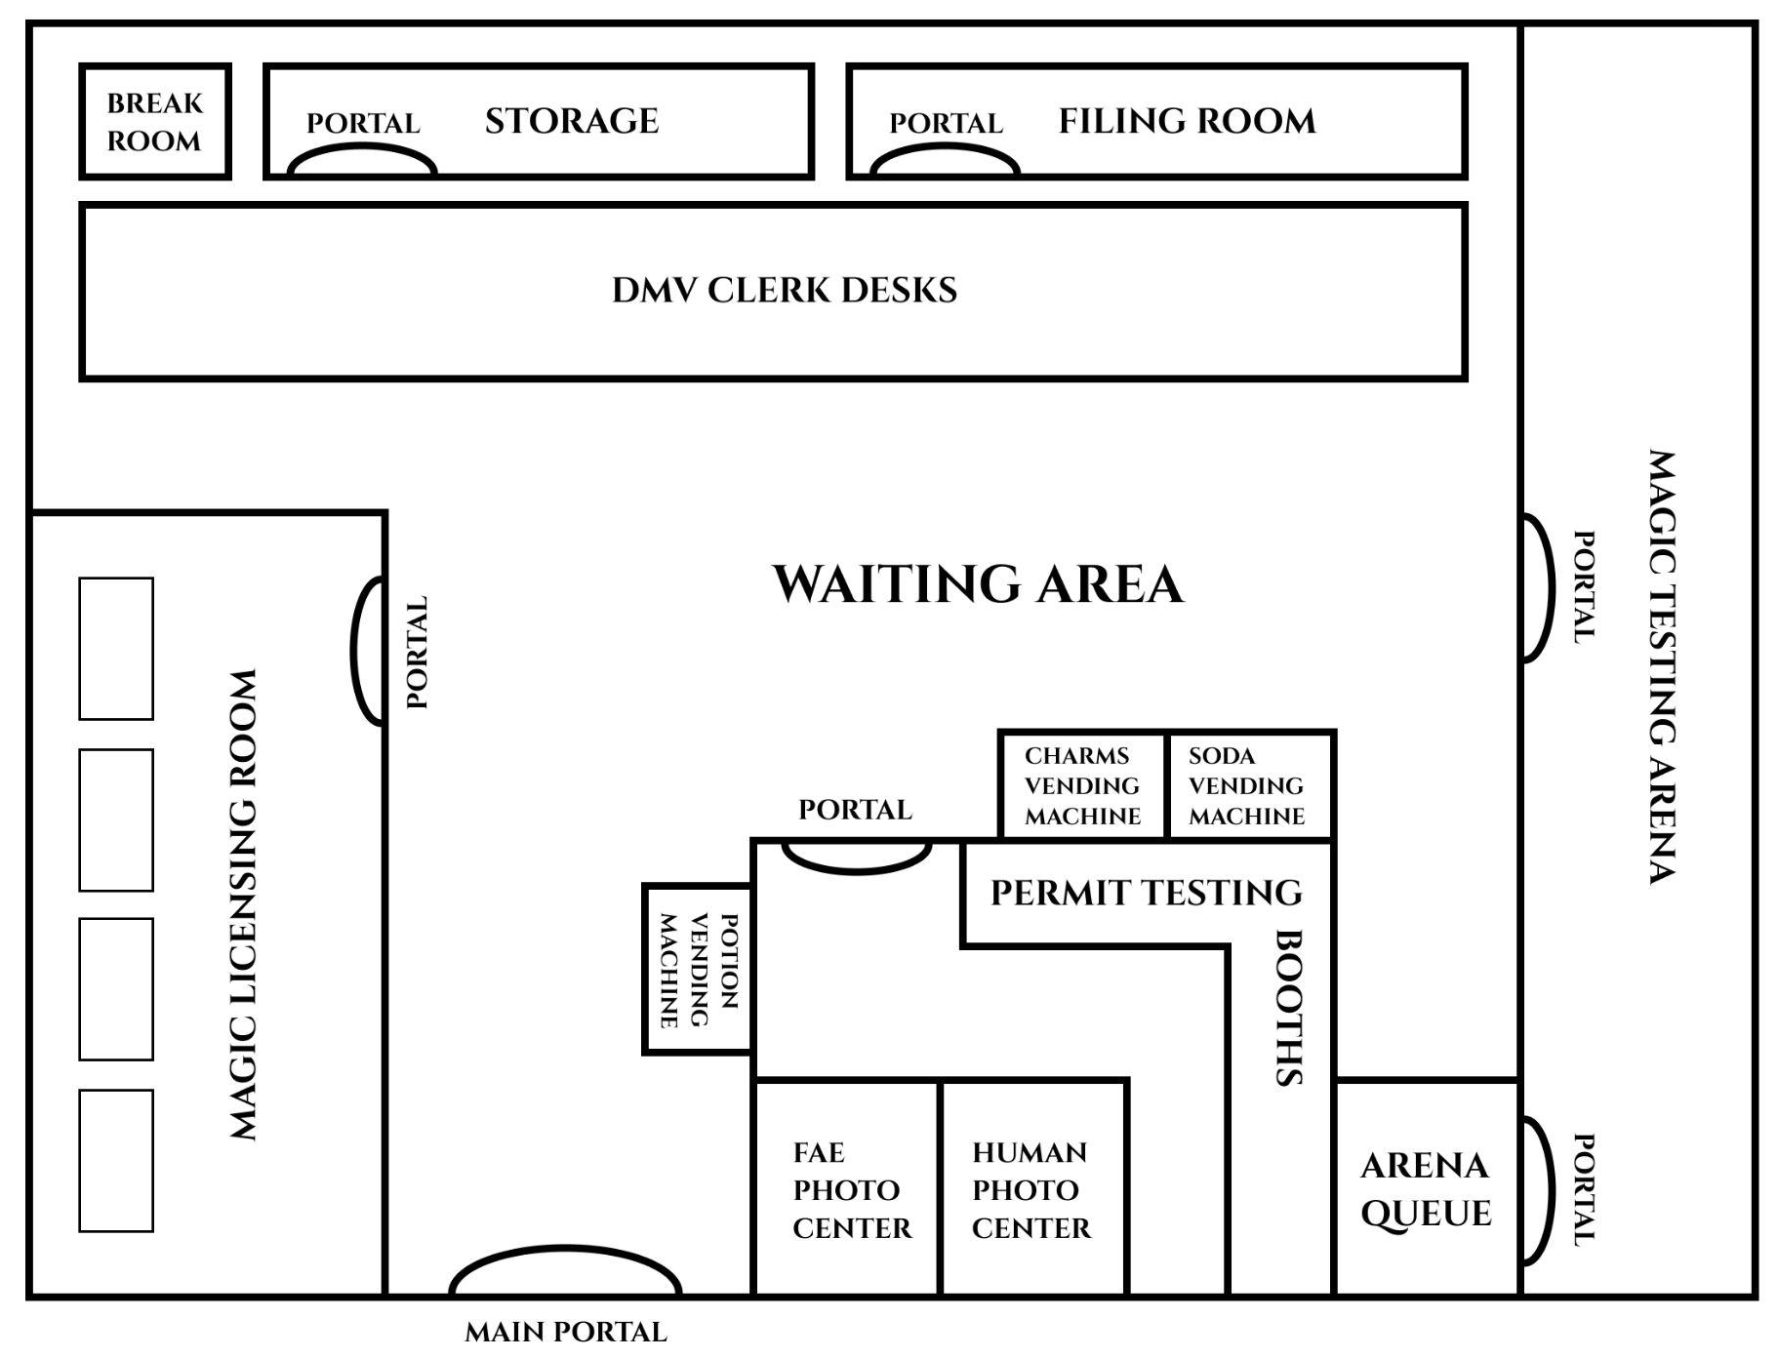
Additional Setting Idea

Slide 4
